Slide 2

289 |  |  |  |  |  |  |  |  |  |  |  |  |  | 276
258 |  |  |  |  |  |  |  |  |  |  |  |  |  |  |  | 275
290 |  |  |  |  |  |  |  |  |  |  |  |  |  |  | 304
257 |  |  |  | 253
252 |  |  |  |  |  |  |  |  |  | 242
204 |  |  |  |  |  |  |  |  |  |  |  |  |  |  |  |  | 220
221 |  |  |  |  |  |  |  |  |  |  |  |  |  |  |  |  |  |  |  | 241
154
144
155
174
201 |  | 203
143
132
118 |  |  |  |  |  |  |  |  |  |  |  |  | 131
093
081
094
106
117
107
001
018
036
019
037
054
55 |  |  |  |  |  |  |  |  |  |  |  |  |  |  |  |  | 72
73 |  |  |  |  |  |  |  |  |  |  | 80

Slide 3
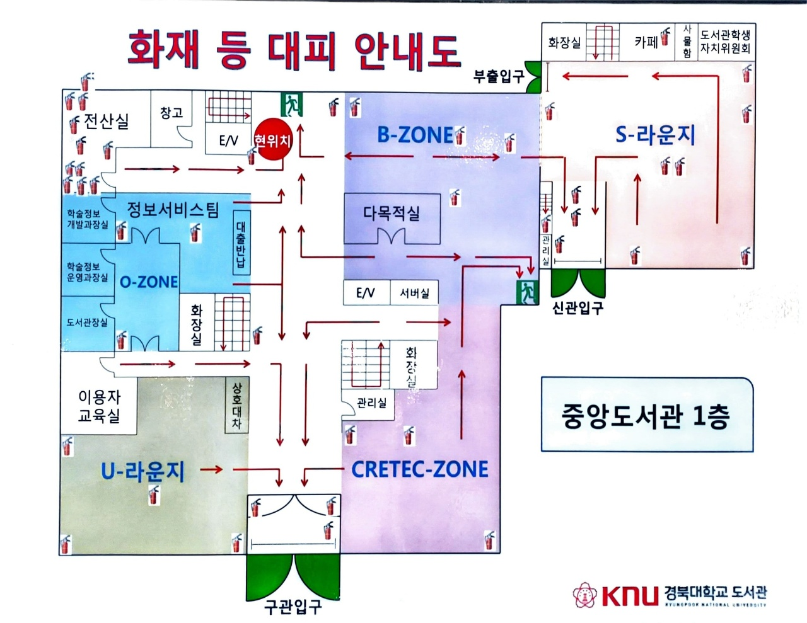

Slide 4
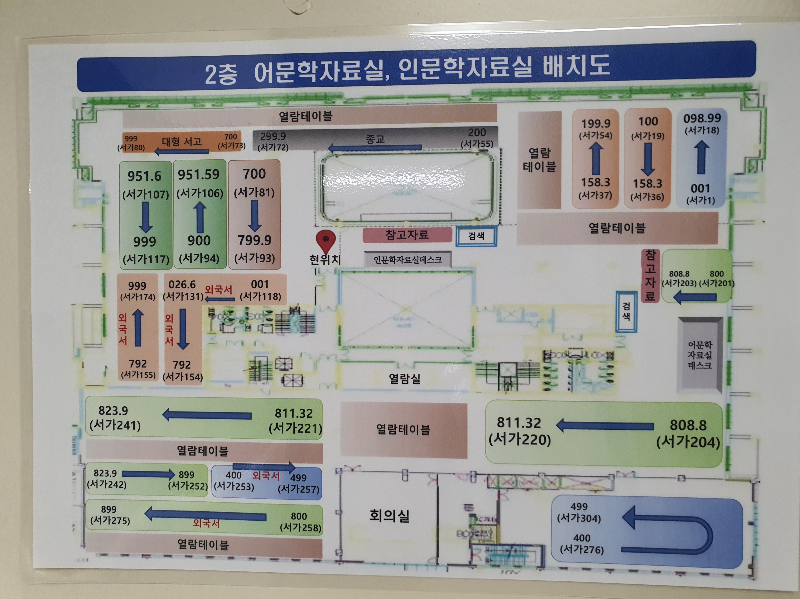

Slide 5
